Slide 1
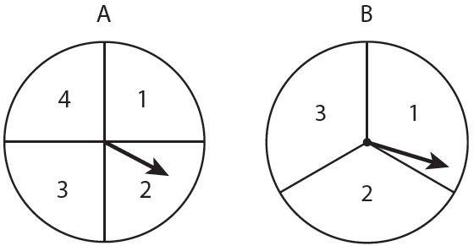
Warm-up
Howard is playing a carnival game. The object of the game is to predict the sum you will get by spinning spinner A and then spinner B.
List the sample space.
What is the probability Howard gets a sum of 5?
Suppose that Howard gets a 3 on Spinner A, what is the new probability of him getting a sum of 5?
3/12 or 1/4
1/3

Slide 2
Conditional Probability

Slide 3
Conditional Probability
Contains a condition that limits (or restricts) the sample space for an event

Slide 4
Conditional Probability
Written as
“The probability of event B, given event A”

Slide 5
Conditional Probability Formula

Slide 6
The table shows the results of a class survey, “Do you own a pet?”
Find P(own a pet | female).
Total of 14 Females. How many in this group own a pet?
 | Yes | No
Female | 8 | 6
Male | 5 | 7

Slide 7
The table shows the results of a class survey, “Did you wash the dishes last night?” Find P(wash the dishes | male).
Total of 15 males. How many in this group washed the dishes
 | Yes | No
Female | 7 | 6
Male | 7 | 8

Slide 8
Using the data in the table, find the probability (as a percent) that a sample of not recycled waste was plastic. P(plastic | not-recycled).
Total of not recycled 156.3. How many in this group waste was plastic?
 | Recycled | Not Recycled
Paper | 34.9 | 48.9
Metal | 6.5 | 10.1
Glass | 2.9 | 9.1
Plastic | 1.1 | 20.4
Other | 15.3 | 67.8

